Slide 1
2 DoF PID Control: Shinskey’s PID_{θ} Controller

Slide 2
2DoF PID Control: PID_{β} Controller

Slide 3
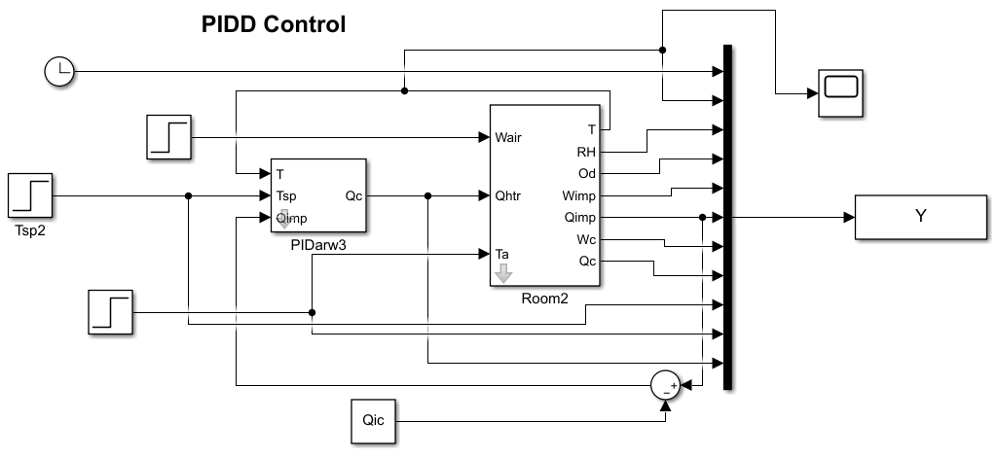
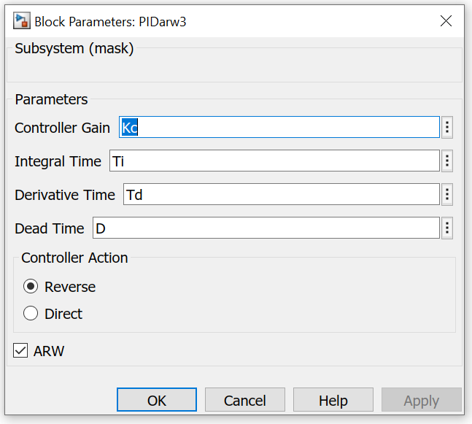

Slide 4
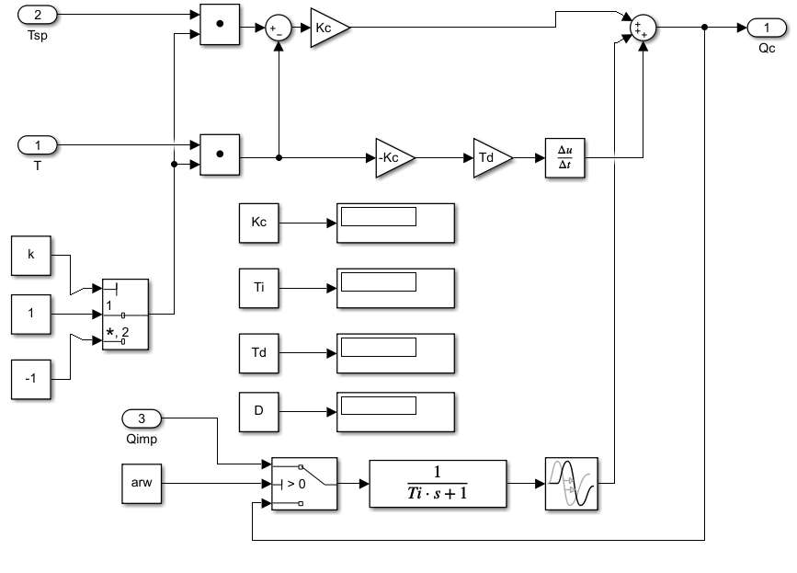

Slide 5
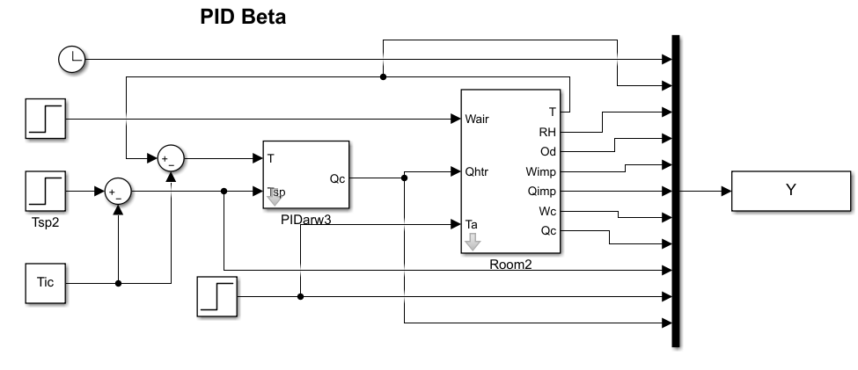

Slide 6
